Slide 1

Predicting Medical Costs
Kristie Kooken

Slide 2
Today’s presentation
Business Problem
Medical Costs in the United States
Data & Methods
Model development
Project results
Next steps
Notes:
Today’s presentation will cover the Business problem that I am addressing in this research project, background on medical costs in the United States, the data and methods used in this project, model development, project results and next steps

Slide 3




Business Problem
3 out of 4 Americans worry
Unexpected medical costs
Cost of health care services
50% of Americans are unable to pay $500 without going in debt
Can financial concerns be avoided by leading more healthy lifestyles?
How do health characteristics influence and predict health care costs?
Notes:
Currently in the united states, 3 out 4 Americans worry about unexpected medical costs or the costs of health care services for themselves or their families
Likewise, about half of adults express that they would not be able to pay an unexpected medical cost of $500 without going into debt
Can Americans avoid these financial concerns by leading more healthy lifestyles? How do health characteristics influence and predict health care costs? The topic that I will investigate for this project will be exploring the relationships between health characteristics and behaviors to determine if these factors can predict insurance medical costs.

Slide 4
Background
Medical Costs in the United States
55% for US citizens
2009 to 2019
Profits for United Health
88.1% during this same time
66% of Americans use private insurance
Notes:
Overall annual private medical costs have soared by 55% from 2009 to 2019 with total costs increasing from 709.5B USD to 1064.1B USD
Conversely, medical insurance companies such as United Health have seen tremendous success with an 88.1% increase in gross profits over this same 10-year period .
Since about 66% of Americans are covered by private health insurance, it is critical to understand the economic impact of medical costs on the American people especially with the overall health outcomes in the United States declining
By investigating what health characteristics can predict medical costs, it would then be possible to develop interventions related to these health characteristics or behaviors.

Slide 5
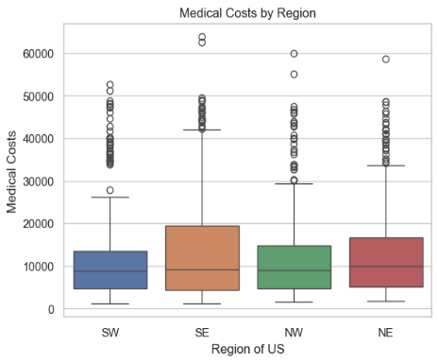
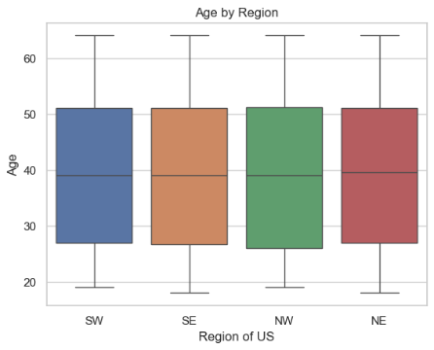
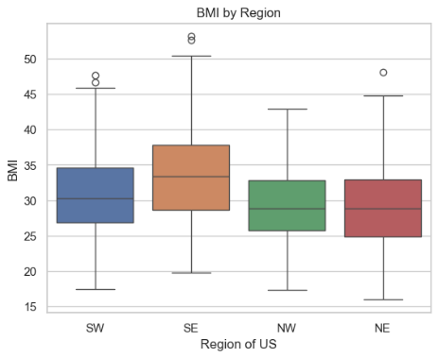
Data & Methods
Medical Insurance data: Kaggle.com
Scrubbed, no missing or duplicates
Age | Age of primary beneficiary
Sex | Insurance contractor gender, female, male
BMI | Body mass index, providing an understanding of body, weights that are relatively high or low relative to height, objective index of body weight (kg/m²) using the ratio of height to weight, ideally 18.5 to 24.9
Children | Number of children covered by health insurance / Number of dependents
Smoker | Smoking Status, Yes/No
Region | The beneficiary's residential area in the US, northeast, southeast, southwest, northwest.
Charges | Individual medical costs billed by health insurance

Slide 6
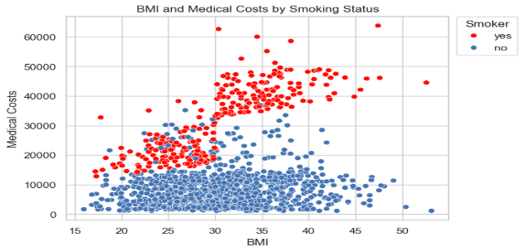
Model Development:
Correlation analysis
Smoker, Medical Costs and BMI
Models for predictions
Not being a smoker had a significant correlation to lower medical costs (r=-0.7872)
Being a smoker had a significant correlation to an increase in BMI (r=0.8911)
Linear Regression
Principal Component Analysis
Random Forest Regression

Slide 7
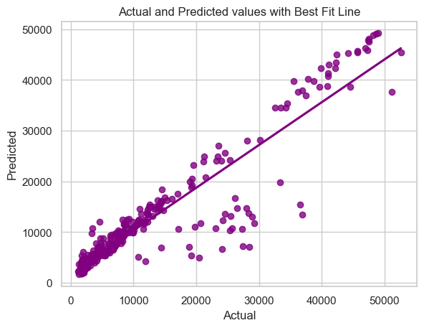
Results: Regression models
Random Forest with Hyper-tuning
Model | R-squared | RMSE
Linear regression | 0.7530 | 6445.6
PCA | 0.7232 | 6824.1
Random forest regression | 0.8058 | 5212.0
Hyper-tuned random forest regression | 0.8194 | 5048.2
Notes:
Model results from all model run yielded acceptable models.
I started with a linear regression then went on to PCA, then Random Forest, looking to see which model would produce the best results.
Random Forest regression yield the best results in terms of the r-quared value as well the smallest root mean squared error. Because of this, hypertuning was performed using this modeling technique.
The results of the hypertuning yielded the highest r2 value and loweset RMSE.
The plot show here is the actual values versus the predicted and it looks pretty good.
When looking at the independent variables relative importance to predicting medical costs, this model showed that being a smoker had the largest effect (0.679680), followed by BMI (0.178373) and Age (0.119367). Other factors like Number of children and Region had smaller contributions to this model.

Slide 8
Next Steps
Smoking is strong predictor of medical costs
BMI and Age also contribute
Additional research is needed
Claims data to identify more predictors of high medical costs
Gov’t data to verify what is found through claims
Reducing medical costs is a grave concern
Gov’t needs to help identify these characteristics
Notes:
The United States has seen a large decrease in cigarette smoking in the past 20 years, with 20.9% of adults smoking in 2005 to 11.5% in 2021 (www.cdc.com). Despite this, smoking has a tremendous economic impact, with smoking-related illnesses costing over 300B USD annually (www.cdc.com). Results from this modeling effort echo this finding, smoking has a tremendous impact on medical costs and an individual can alter potential health costs by not smoking.

Slide 9
Questions ?

